Slide 1
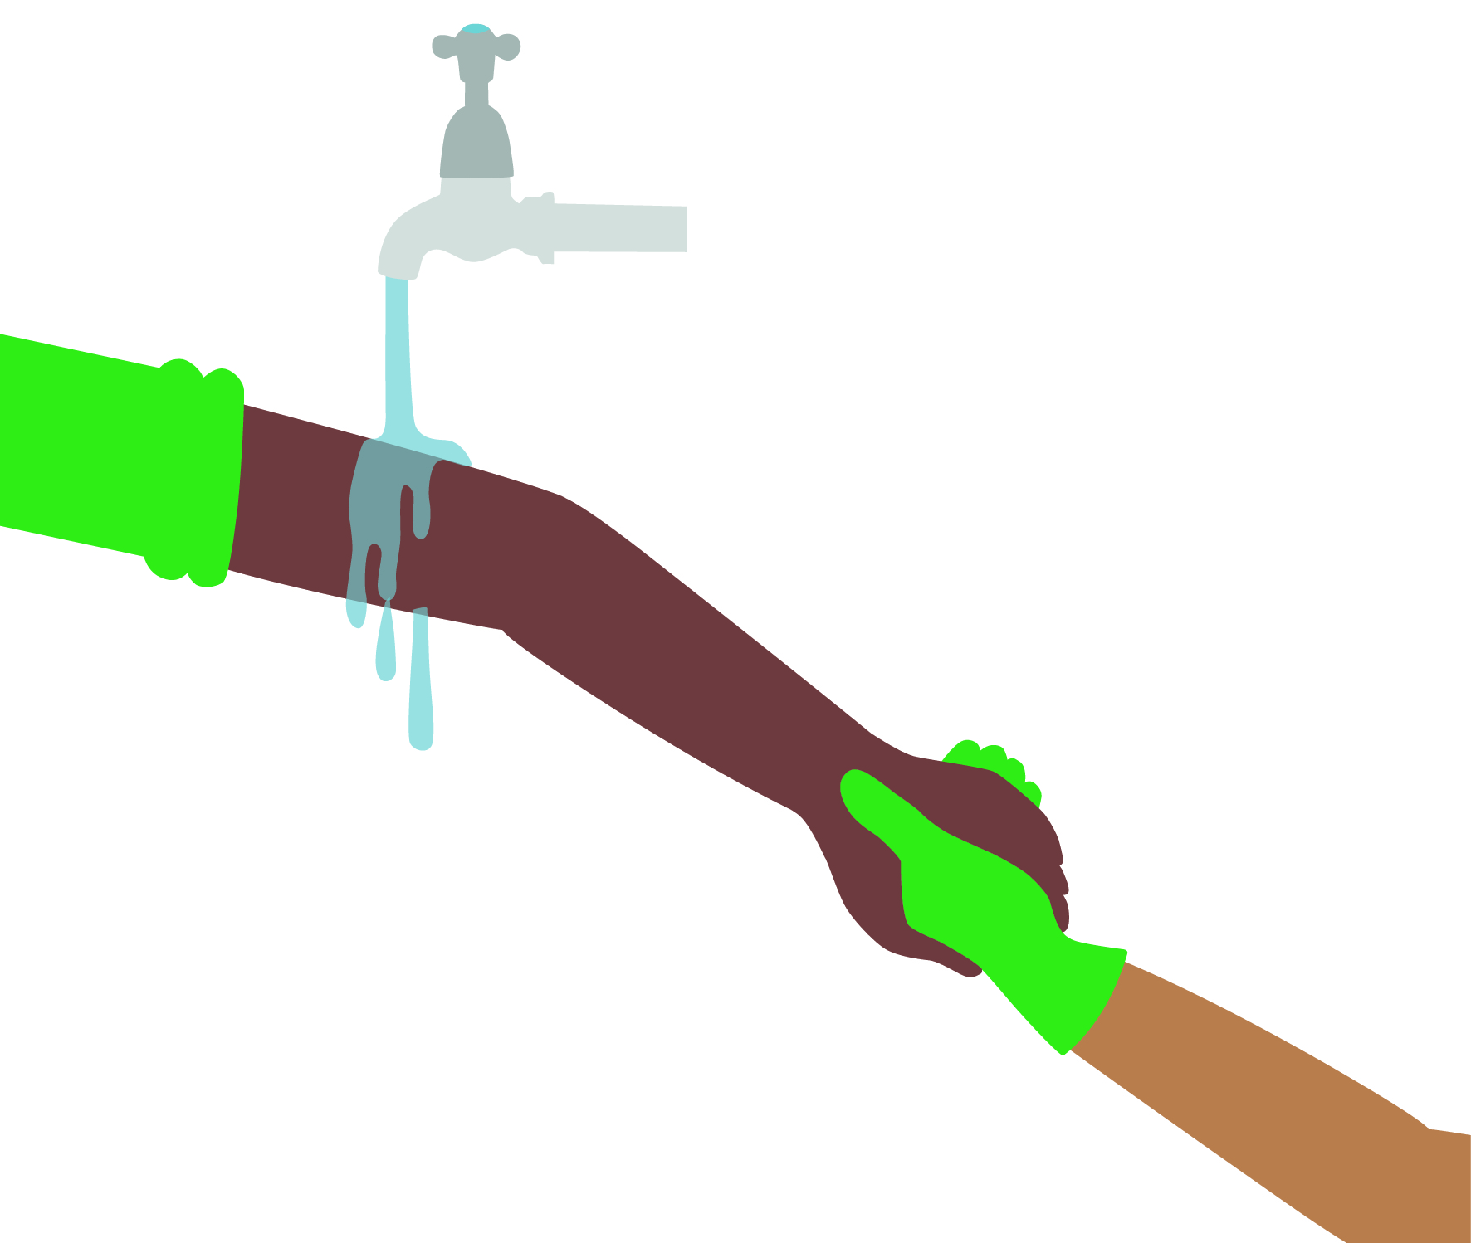
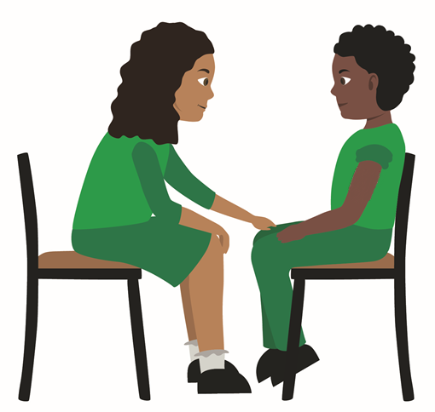
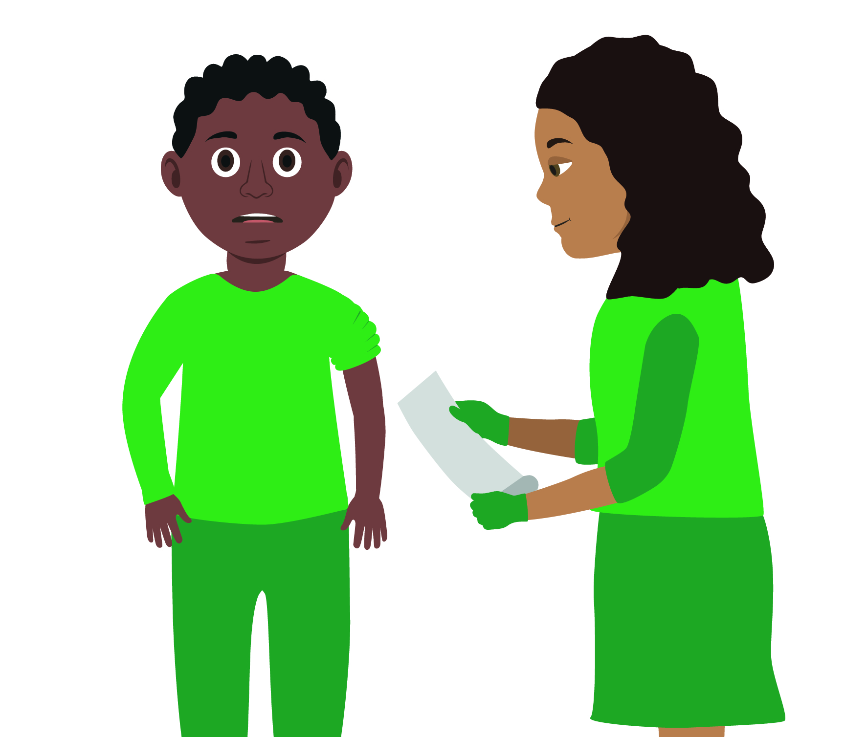
Your turn:
Treating bites
1. Reassure the casualty
Help them to sit or lie down
2. Clean
Wash the wound thoroughly with soap and water to minimise the risk of infection
3. Raise and support the wound
Then pat dry with clean gauze swabs
4. Cover bite
Use a sterile wound dressing
5. Extra help
If the wound is large or deep arrange for the casualty to be taken to hospital
For other bites which pierce the skin seek medical advice
Notes:
In pairs/ small group demo management of an animal/human bite

